Slide 1


Perceptual Dissimilarity and Intra–Speaker Indication
Sidharth Gulati, Tushar Sudhakar Jee, Da Teng
University of California, Los Angeles
Henry Samueli School of Engineering and Applied Science
Electrical Engineering Department
March 09, 2016

Slide 2

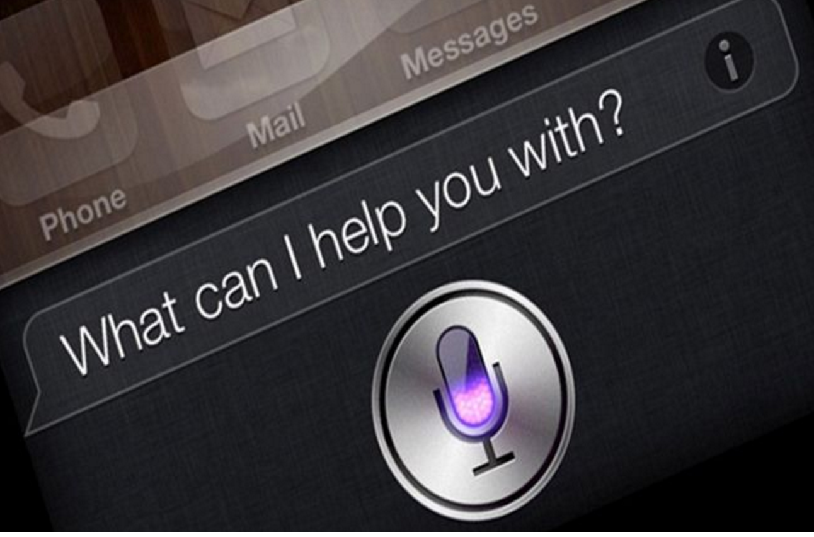

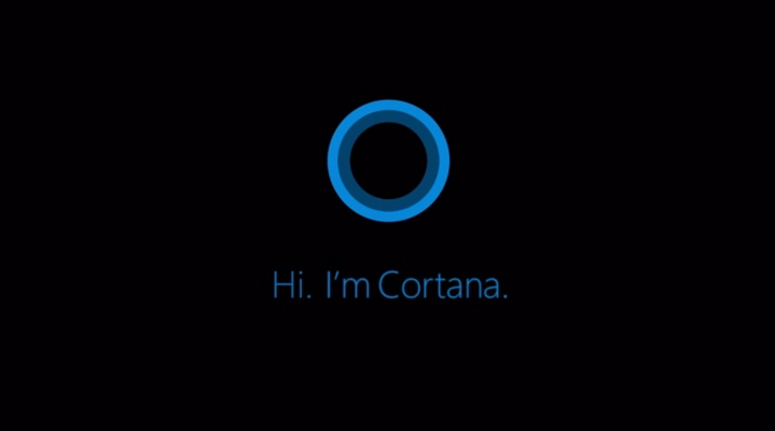
Outline
• Problem description and motivation
• Algorithm design
• Experimental results
• Future work and conclusion

Slide 3
Problem description and Motivation
• Finding a set of acoustic features and algorithms that predict the perceptual dis-similarity and provide a measure of intra speaker indication.
•Speaker recognition is a potential technology that is continuously evolving to make our daily lives more secure. Applications include protection of electronic belongings, command and control, transcription of recorded speech and searching audio documents.
• A type of Biometric used to identify and authenticate users based on their voice.

Slide 4
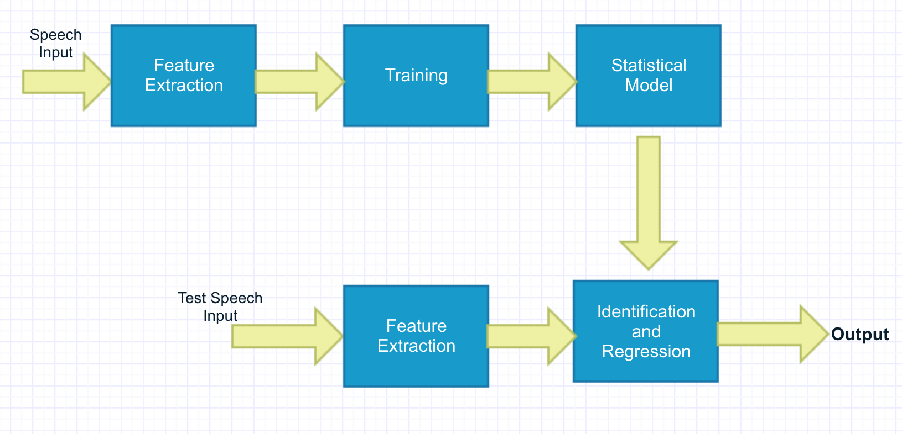
Algorithmic Design
Flowchart

Slide 5
Feature Extraction

Slide 6
Cepstral Peak Prominence (CPP)
•Evaluated using VoiceSauce.
•It is the difference in amplitude between the Cepstral peak and the corresponding value on the regression line directly below the peak.
•A robust and promising acoustic measure of Dysphonia severity.
•Dysphonia is an inability to produce voice sounds( most often vowel) due to impairment of vocal organ.
•Decreased mean Cepstral peak values found in dys-phonic individuals.

Slide 7
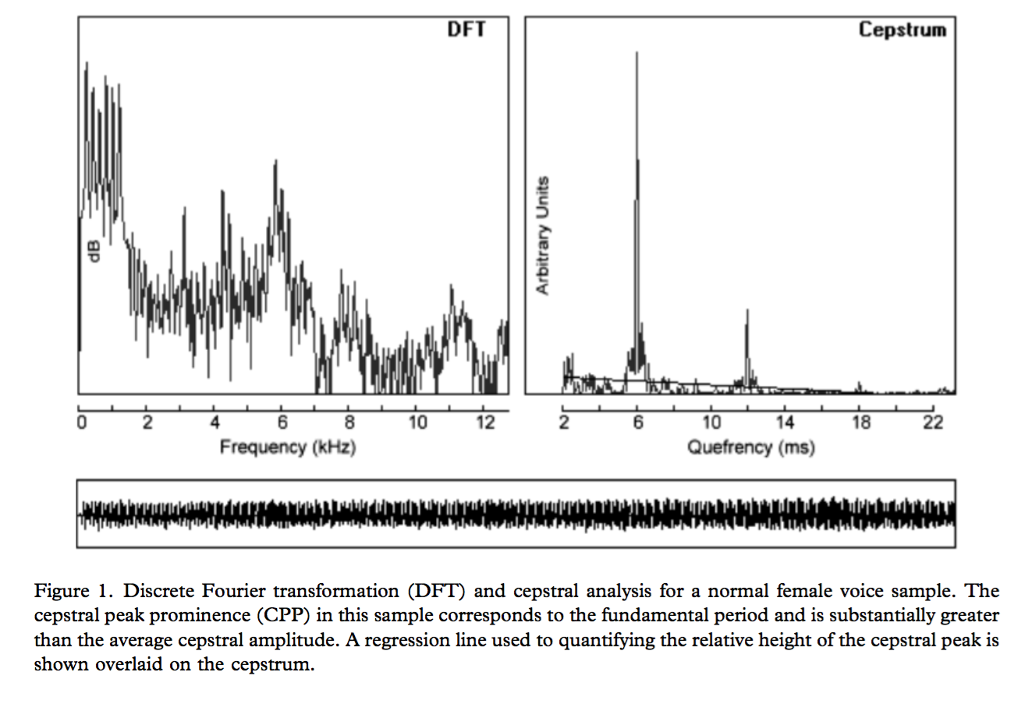
Cepstral Peak Prominence (CPP)

Slide 8
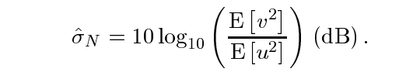
Harmonics-to-Noise Ratio (HNR)
•Evaluated using VoiceSauce.
•Used as measure of relative amplitudes of the voiced and unvoiced components.
•Detects cycle-to-cycle perturbations. Helps understand relation between Harmonic structure energy, from the speech signal, and the additive noise due to different voice disorders.
•Auditive impression of a voice with a low HNR is overwhelmingly hoarse, whereas a voice with a very high HNR sounds hypertensive/pressed

Slide 9
H1-H2
•Evaluated using VoiceSauce.
• It indicates relative length of the opening phase of the glottal pulse.
• Airway at the vocal cord level is the glottis.
•Adduction occurs when the vocal folds come together to close the glottis.
•Differences in amplitudes of the first and second harmonics (H1, H2) are useful for quantifying degree of glottal adduction in different voices perceived.

Slide 10
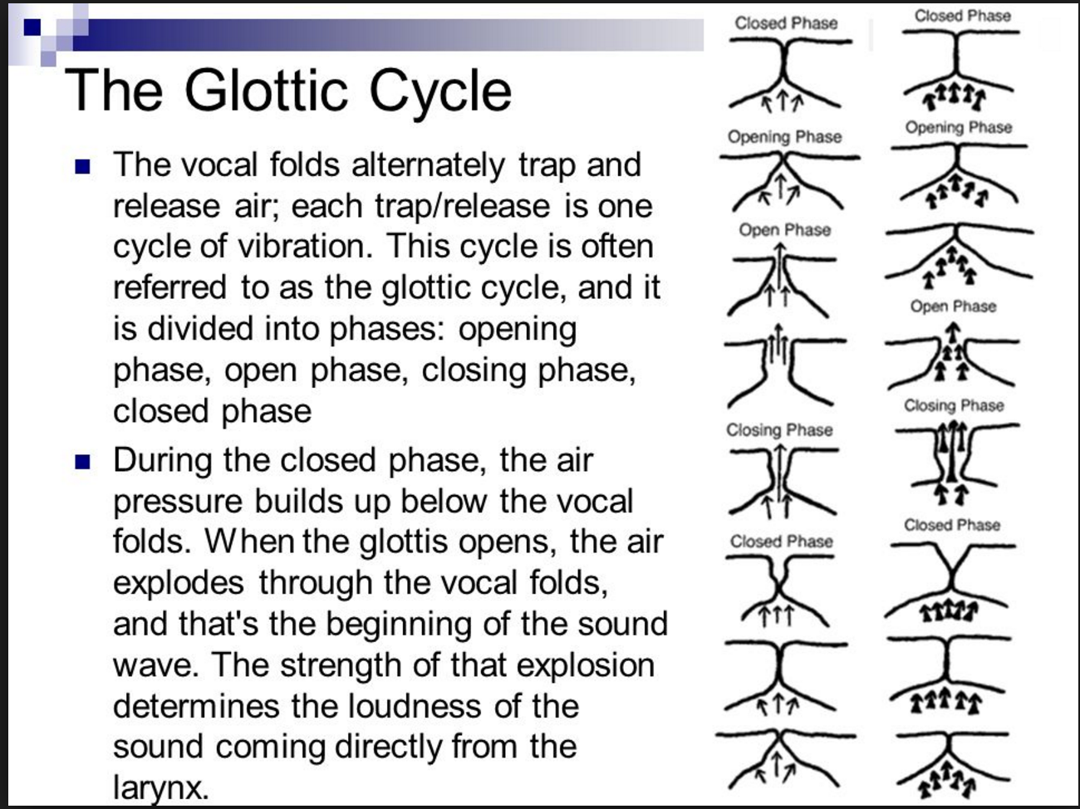
H1-H2

Slide 11
F0, F1, F2
Low frequency features
• F0 – fundamental frequency of glottal vibration. Different speaker will be measured with different values, in general
• Temporal variation of F0 (known as pitch contour), is useful as speaker cue
• Relations are found between F1 and closing of oral cavity, F2 and the back displacement of the tongue

Slide 12
F3, F4 – Features of the Vocal Tract
High frequency formants
• Formants provide info about shape and length of vocal tract (voiced speech)
• In general, F1, F2 varies considerably; F3, F4 stays steady. Taking average across frames for F3, F4 makes more sense.
• Calculate F1 ~ F4 for each frames, and take average across frames. So each formant has one value as feature
• Even higher order formant discarded since Fs = 22,050Hz.

Slide 13
Mel-Frequency Cepstrum Coefficient
• Converting to Mel scale through grouping by filterbank mimics how cochlea discerns frequency differences: higher resolution in low frequency
• Taking DCT to the log of energies produced by filterbank produce coefficients as features
• Using first few DCT coefficients keeps the “shape” of the mel-frequency spectrum
• DCT does a good job to aperiodic spectrum with fewer coefficients
• We used 13 MFCC coefficients in total for each speech file. Taking average across frames.

Slide 14
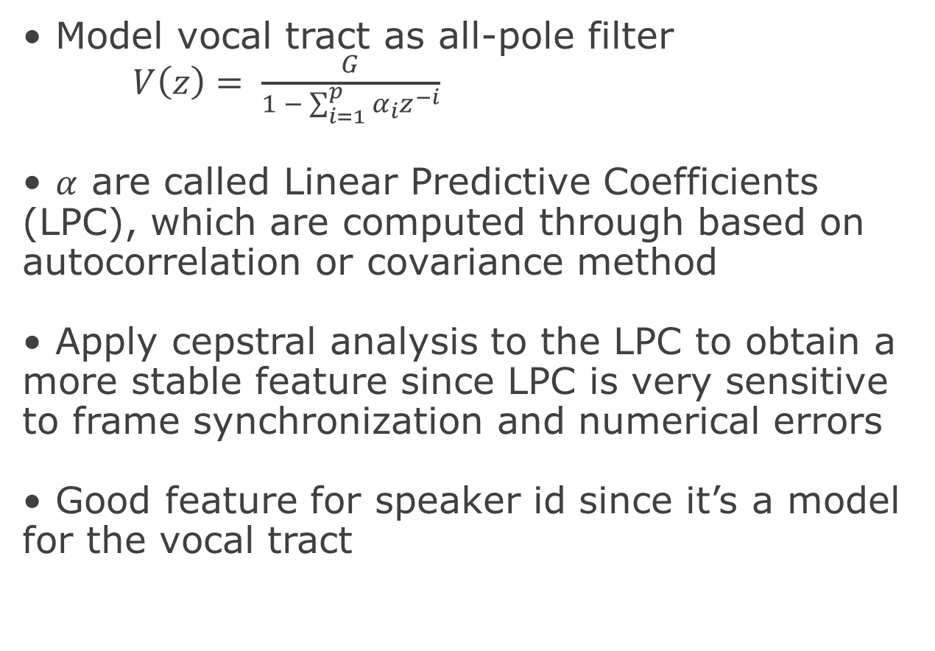
Linear Predictive Cepstral Coefficients (LPCC)
• Model vocal tract as all-pole filter
$V\left(z\right)= \frac{G}{1 − \sum_{i=1}^{p}{α_{i}z^{−i}}}$
• $α$ are called Linear Predictive Coefficients (LPC), which are computed through based on autocorrelation or covariance method
• Apply cepstral analysis to the LPC to obtain a more stable feature since LPC is very sensitive to frame synchronization and numerical errors
• Good feature for speaker id since it’s a model for the vocal tract

Slide 15
Experimental Results

Slide 16
Experimental Results
Feature Dimension
• We used 71 features for training and testing in this project. The break up of features is given below :
Feature | Number
F0 | 1
F1 | 1
F2 | 1
F3 | 1
F4 | 1
HNR | 1
CPP | 1
H1-H2 | 1
MFCC | 13
LPCC | 50
 | 71

Slide 17
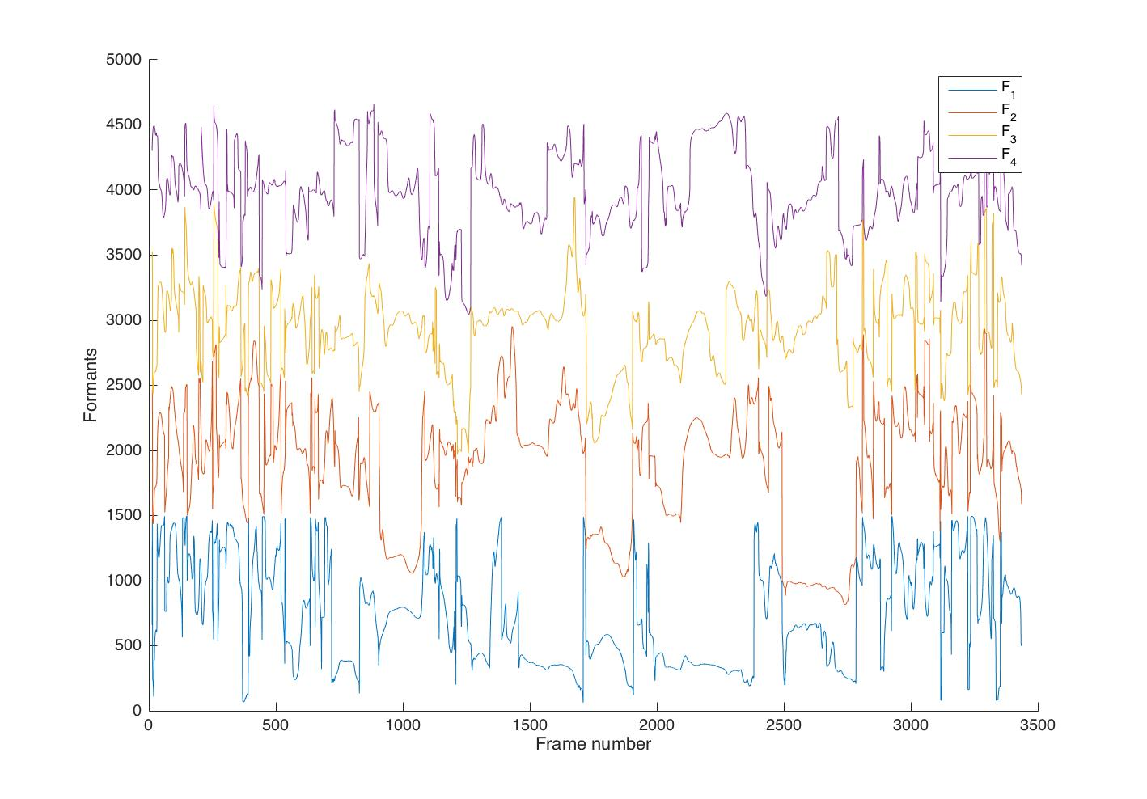
Experimental Results
• Below is a sample formant plot for speaker 51A_2a.

Slide 18
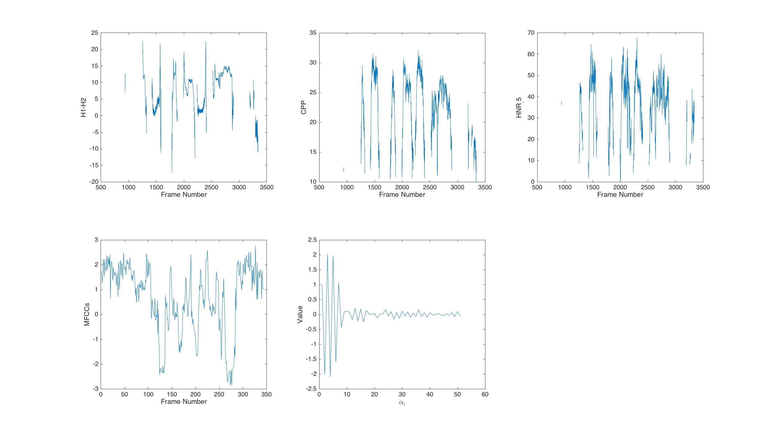
Experimental Results
• Below are sample H1-H2, CPP, HNR,
MFCC (⍺₄) and LPCC plots for speaker 51A_2a.

Slide 19
Experimental Results
Perceptual Dissimilarity
• We used Bagged Trees Ensemble method for predicting Perceptual Dissimilarity.
• The minimum Average Root Mean Square Error for Perceptual Dissimilarity was found to be 1.88.
• AdaBoost Trees were used for Speaker Recognition.
• Minimum Classification Error Rate was 3.33%.
Intra Speaker Indication

Slide 20
Experimental Results
Classification Error For Different Classifiers
Classification Error
AdaBoost (Num. of Trees = 100) | SVM | Naïve Bayes
3.333333333 | 27.33333333 | 11.66666667
• As it is evident from the above table, minimum classification error was achieved using Ensemble(AdaBoost) Classifier.
• The accuracy of SVM is low because there is not enough data to train high dimension support vectors.

Slide 21
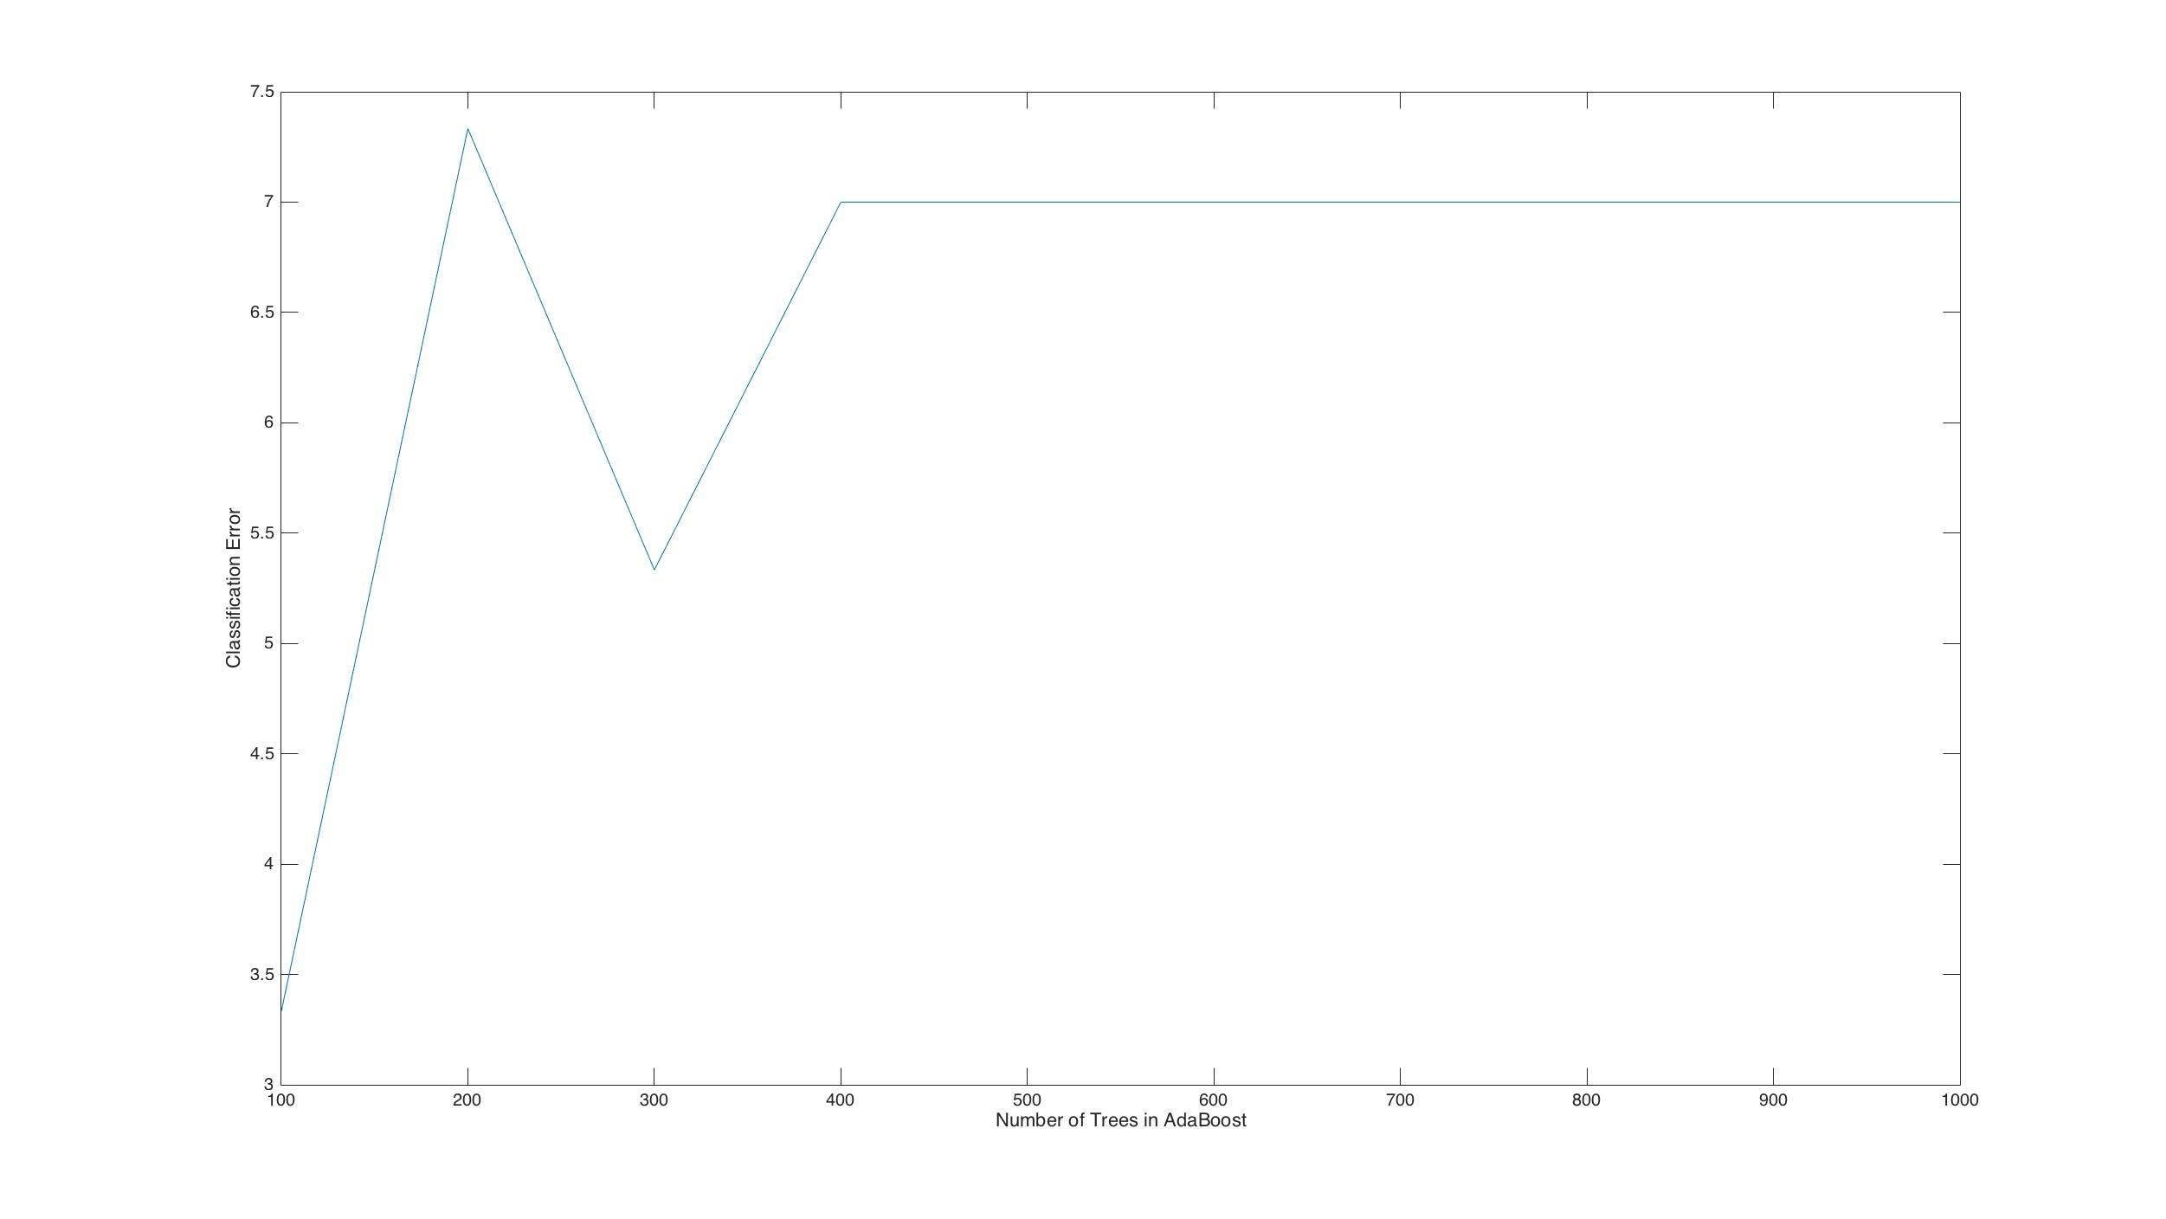
Results (Intra-Speaker Indication)
• The above figure shows the variation of Classification Error with respect to number of Trees in the Ensemble Method.
• As you can see, minimum classification error was 3.33%, achieved with 100 Trees in the Ensemble.

Slide 22
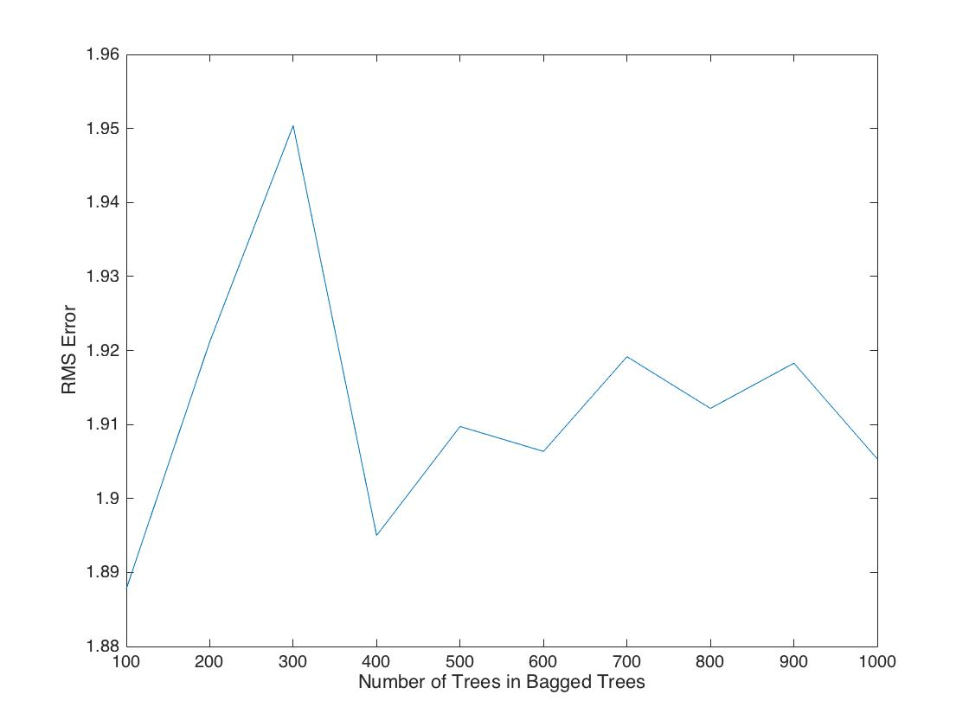
Results (Perceptual Dissimilarity)
• The above figure shows the variation of RMS Error with respect to number of Trees in the Ensemble (Bag) Method used for Regression.
• As you can see, minimum RMS Error was 1.88, achieved with 100 Trees in the Ensemble.

Slide 23
What else we tried and observed?
• For using Formants(F1 - F4) as features, we tried modelling them using Gaussian Mixture Model, but the classification error rate was high that is, around 9%. Also, the RMS error was 2.43, which is quite high.
• But, when we used the average value of corresponding formants as features, classification error considerably dropped to 3.33% and a RMS error of 1.88.
• Same, technique was done for using MFCCs as features, but the classification rate was quite high(~15%). But, with mean value of MFCC it dropped considerably to 3.33%.

Slide 24
Conclusion
• The goal of the project was to build a system that could discern the perceptual properties of different speaker and thereby, predicting the measure of intra – speaker indication.
• This project implemented 2 well known features namely, MFCC and LPCC along with formants, pitch period, CPP, HNR and the difference between first and second harmonics.
• Though, in general, F1 and F2 vary considerably, but the finding of this project suggest that F1 and F2 not vary considerably, thereby giving a high accuracy rate for perceptual dissimilarity and intra-speaker indication.

Slide 25
Future Work
• In the second stage, we wish to analyze the system having speech data under the influence of noise. We also plan to have a system to identify speakers using conversational speech data.
• We tried using GMM with M =4,8,16 but the efficiency was not good, due to small dataset. We wish to model the voice features using GMM with a large dataset and analyze the perceptual dissimilarity.
• In an another attempt, we would like to analyze voiced and unvoiced segments of the speech separately and test on the same dataset.

Slide 26
References
• Kreiman, J., Park, S. J., Keating, P. A., & Alwan, A. (2015). The Relationship Between Acoustic and Perceived Intraspeaker Variability in Voice Quality. In Sixteenth Annual Conference of the International Speech Communication Association.
• Nolan, F., McDougall, K., & Hudson, T. (2011, August). Some acoustic correlates of perceived (dis) similarity between same-accent voices. InProceedings of the 17th International Congress of Phonetic Sciences, Hong Kong (Vol. 17, No. 21, pp. 1506-1509).
• http://www.ee.ic.ac.uk/hp/staff/dmb/voicebox/voicebox. html - Voicebox

Slide 27
References
• Espy-Wilson, C. Y., Manocha, S., & Vishnubhotla, S. (2006, September). A new set of features for textindependent speaker identification. In INTERSPEECH.
• Kinnunen, T., & González-Hautamäki, R. (2005, October). Long-term f0 modeling for text-independent speaker recognition. In Proceedings of the 10th International Conference Speech and Computer (SPECOM), Patras, Greece (pp. 567-570).
• Y.-L. Shue (2010), The voice source in speech production: Data, analysis and models. UCLA dissertation.

Slide 28
Finish Line!!!
Thank You
Questions?

